Slide 1

Bioinformatics and Genomics application in medicine Dr. Yassine Kasmi

Slide 2





Key Topics in Medical Bioinformatics
NGS and Bioinformatics Introduction
NGS Data Quality Control
Variant Calling and Analysis
Single Cell RNA Sequencing
Microbiome profiling and metagenomics

Slide 3
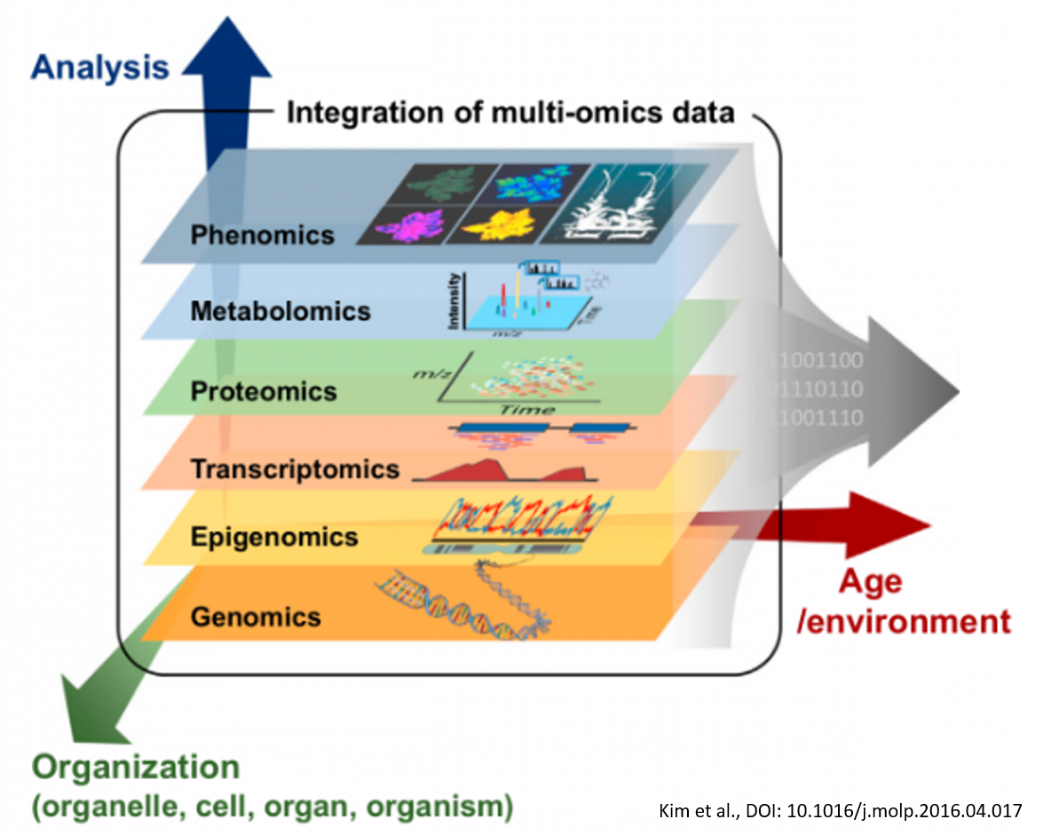
Central Dogma

Slide 4
Central Dogma

Slide 5
Central Dogma
DNA
Genomics
mRNA
Protein
Transcriptomics
Proteomics
Phenomics
Phenomics

Slide 6
Complex System Biology
eDNA
CH
Genomics
exDNA
Free DNA
lncRNA
miRNA
Transcriptomics
mRNA
piRNA
mRNA
CHIP
Epigenetics
BiS
proteomics

Slide 7
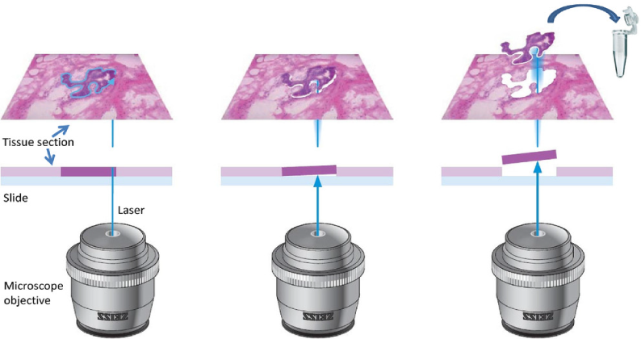
Spatial Genomics

Slide 8
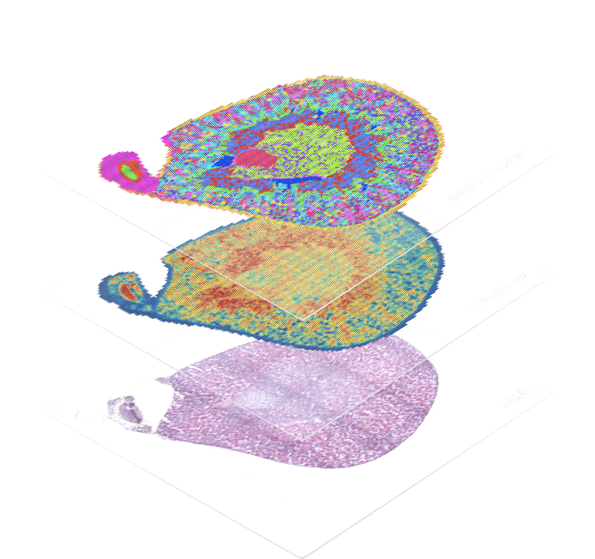
Spatial Genomics
Sc-sequencing
Geo

Slide 9
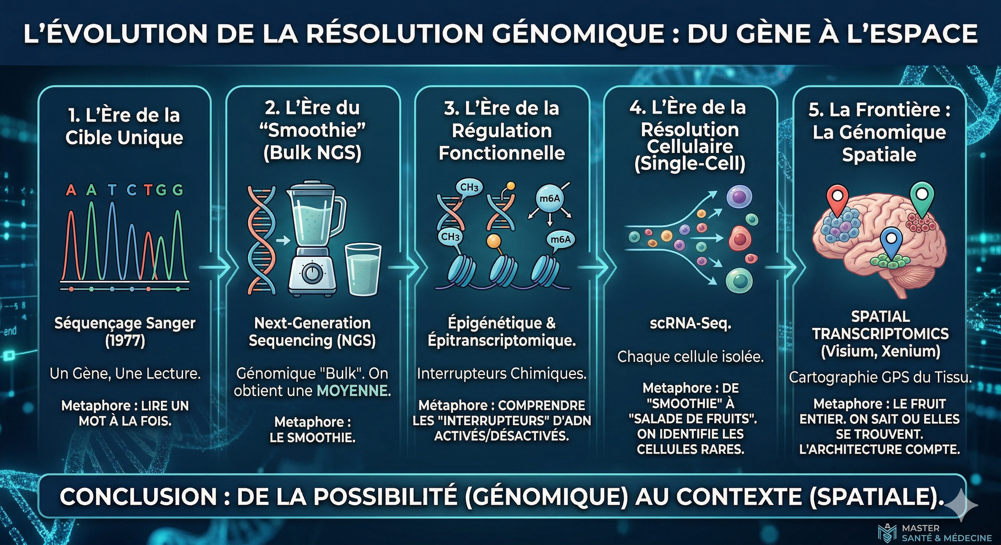

Slide 11
Introduction to Linux
Why command line and not GUI

Slide 12

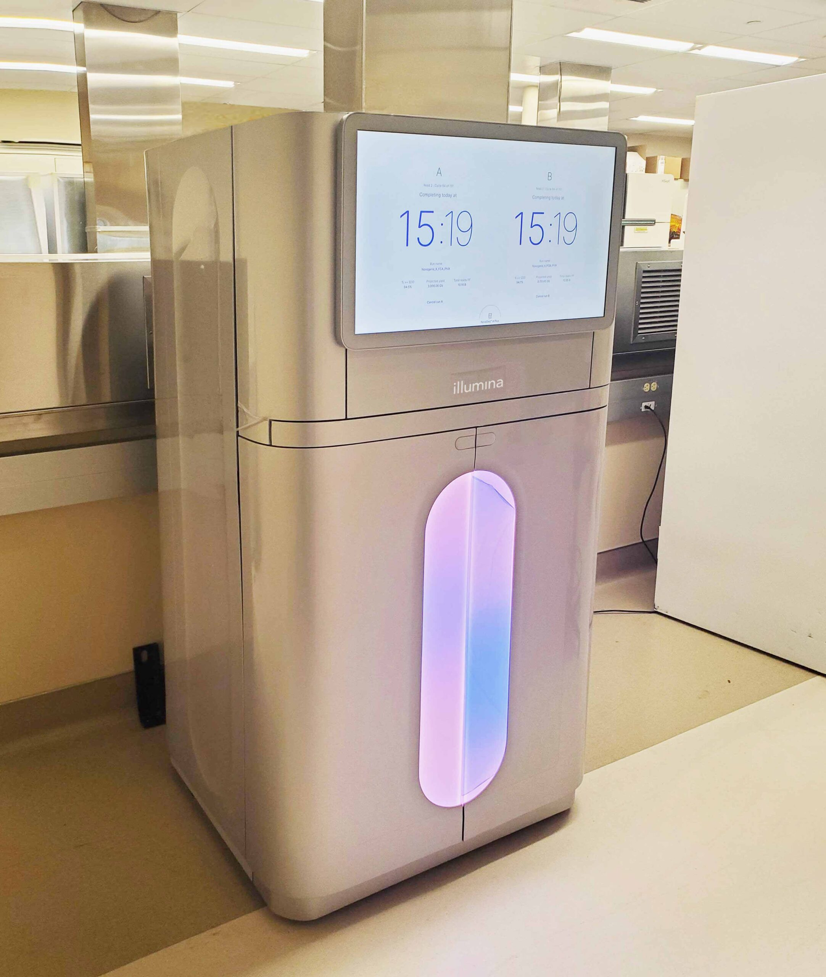

Slide 13


Novaseq X plus
1 run B25 flow cell => 25 Tb (~40h)
~ +4000 Movie HD ~ 200 Million books
How to analyse all this data ?

Slide 14
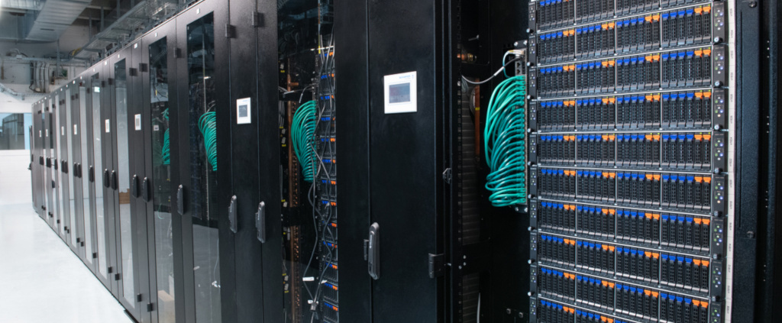
You need more resources than what is available on your laptop

Slide 15
